Slide 1
Joint DOA Estimation and Source Signal Tracking With Kalman Filtering and Regularized QRD RLS Algorithm
Jian-Feng Gu, Student Member, IEEE, S. C. Chan, Member, IEEE, Wei-Ping Zhu, Senior Member, IEEE, and M. N. S. Swamy, Fellow, IEEE
(IEEE Transactions On Circuits and Systems 2013)
Presented By:
Harutjun Magakyan

Slide 2
Goals
Present a different approach to DOA estimation
Familiarize with the tools and techniques used in the paper
Make the paper more accessible to the reader

Slide 3
Outline
Introduction
The Problem
DOA Estimation techniques
Familiarization With Tools And Concepts In The Paper
KF – Kalman Filter
AR – Auto-Regressive Models
QRD - RLS – QR-Decomposition based Recursive Least Squares algorithm
Project Approximation Subspace Tracking
Proposed Solution
Results Comparisons and Conclusions

Slide 4
Introduction The Problem
We wish to accurately estimate Direction Of Arrival (DOA) of signals and track it as they move in space (The target signals are dynamic).
Why ?
Communications
Air-Traffic control
Speaker tracking in smart-home applications
Electronic-reconnaissance
We want to achieve good results with low computational costs real-time/online application

Slide 5
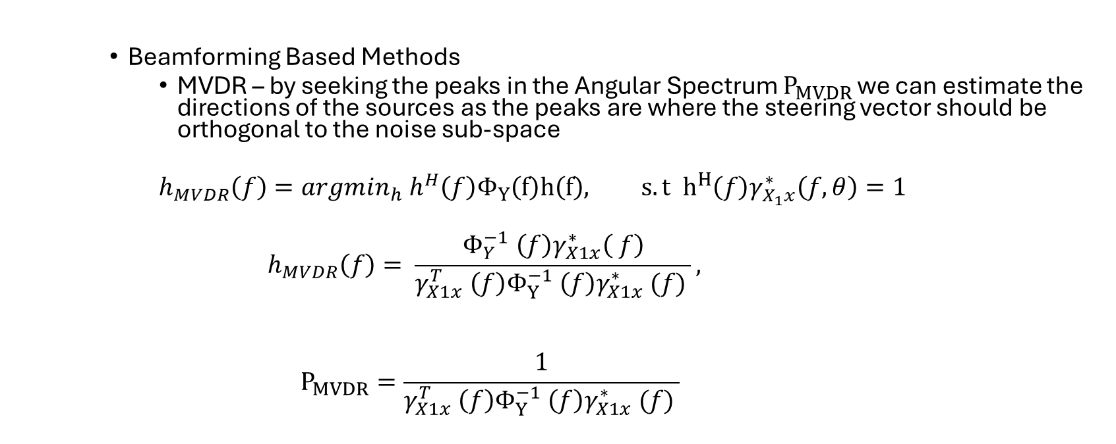
Introduction Existing Solutions
Beamforming Based Methods
MVDR – by seeking the peaks in the Angular Spectrum $P_{MVDR}$ we can estimate the directions of the sources as the peaks are where the steering vector should be orthogonal to the noise sub-space
$$h_{MVDR}\left(f\right)=argmin_{h} h^{H}\left(f\right)Φ_{Y}\left(f\right)h\left(f\right), s.t h^{H}\left(f\right)γ_{X_{1}x}^{∗}\left(f,θ\right)=1$$
$$h_{MVDR}\left(f\right)= \frac{Φ_{Y}^{−1} \left(f\right)γ_{X1x}^{∗}\left( f\right)}{γ_{X1x}^{T} \left(f\right)Φ_{Y}^{−1} \left(f\right)γ_{X1x}^{∗} (f) },$$
$$P_{MVDR}=\frac{1}{γ_{X1x}^{T} \left(f\right)Φ_{Y}^{−1} \left(f\right)γ_{X1x}^{∗} (f) }$$

Slide 6
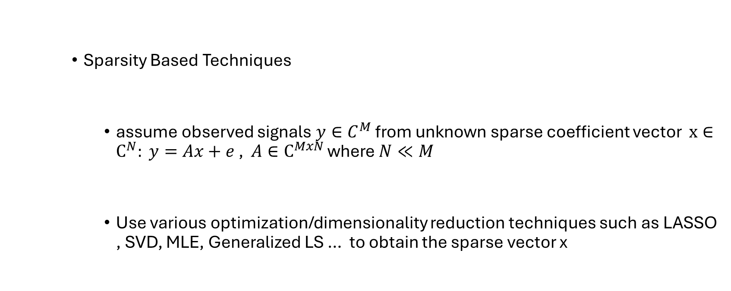
Introduction Existing Solutions
Sparsity Based Techniques
assume observed signals $y∈C^{M}$ from unknown sparse coefficient vector $x∈C^{N}: y=Ax+e$ , $A∈C^{MxN}$ where $N≪M$
Use various optimization/dimensionality reduction techniques such as LASSO , SVD, MLE, Generalized LS … to obtain the sparse vector x

Slide 7
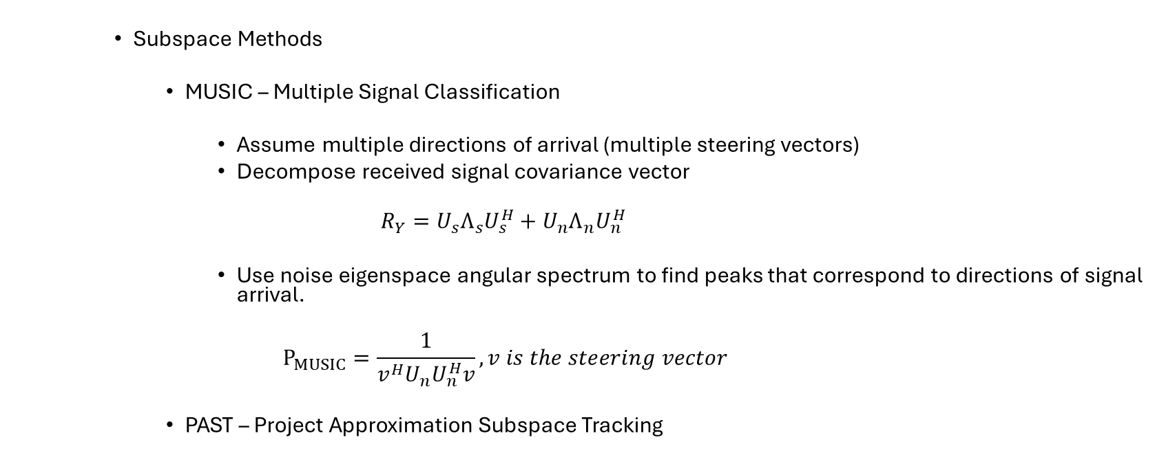
Introduction Existing Solutions
Subspace Methods
MUSIC – Multiple Signal Classification
Assume multiple directions of arrival (multiple steering vectors)
Decompose received signal covariance vector
$$R_{Y}=U_{s}Λ_{s}U_{s}^{H}+U_{n}Λ_{n}U_{n}^{H}$$
Use noise eigenspace angular spectrum to find peaks that correspond to directions of signal arrival.
$$P_{MUSIC}=\frac{1}{v^{H}U_{n}U_{n}^{H}v}, v is the steering vector$$
PAST – Project Approximation Subspace Tracking

Slide 8
Introduction The PAST Algorithm
The Projected Approximation Subspace Tracking (PAST) algorithm is a method used for tracking the dominant subspace of a time-varying data matrix. It is commonly applied in the field of adaptive signal processing and is particularly useful in scenarios where the data matrix undergoes changes over time, such as in adaptive beamforming, channel equalization, and system identification.
The PAST algorithm is designed to iteratively update an estimate of the dominant subspace of the data matrix while adapting to changes in the underlying subspace structure. It is a computationally efficient and numerically stable algorithm that is well-suited for online processing.
A high-level overview of how the PAST algorithm works:
1. Initialization: Initialize the algorithm by choosing an initial estimate of the dominant subspace, typically represented by a set of orthogonal basis vectors.
2. Iterative Update: At each iteration, the PAST algorithm updates its estimate of the dominant subspace based on the current input data vector.
3. Projection: Project the current input data vector onto the subspace estimate to obtain the projection coefficients.
4. Adaptation: Update the subspace estimate by adapting the basis vectors using the projection coefficients and the input data vector.
5. Normalization: Orthogonalize the updated basis vectors to ensure orthogonality and maintain a valid subspace representation.
6. Rank Adaptation: Optionally, the PAST algorithm can adaptively adjust the rank of the subspace estimate based on the magnitude of the projection coefficients.
By iteratively repeating these steps as new data becomes available, the PAST algorithm continuously tracks changes in the dominant subspace of the data matrix. It is robust to noise and can effectively handle non-stationary data while requiring relatively low computational complexity.

Slide 9
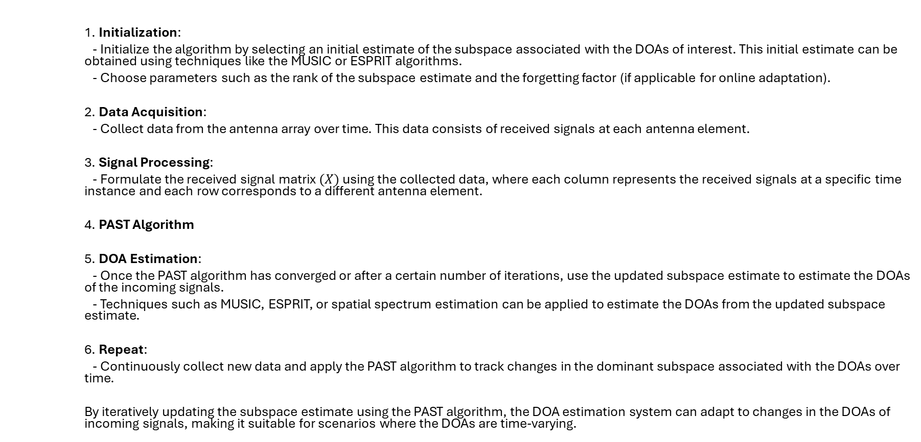
Introduction The PAST Algorithm for DOA estimation
1. Initialization:
- Initialize the algorithm by selecting an initial estimate of the subspace associated with the DOAs of interest. This initial estimate can be obtained using techniques like the MUSIC or ESPRIT algorithms.
- Choose parameters such as the rank of the subspace estimate and the forgetting factor (if applicable for online adaptation).
2. Data Acquisition:
- Collect data from the antenna array over time. This data consists of received signals at each antenna element.
3. Signal Processing:
- Formulate the received signal matrix $(X)$using the collected data, where each column represents the received signals at a specific time instance and each row corresponds to a different antenna element.
4. PAST Algorithm
5. DOA Estimation:
- Once the PAST algorithm has converged or after a certain number of iterations, use the updated subspace estimate to estimate the DOAs of the incoming signals.
- Techniques such as MUSIC, ESPRIT, or spatial spectrum estimation can be applied to estimate the DOAs from the updated subspace estimate.
6. Repeat:
- Continuously collect new data and apply the PAST algorithm to track changes in the dominant subspace associated with the DOAs over time.
By iteratively updating the subspace estimate using the PAST algorithm, the DOA estimation system can adapt to changes in the DOAs of incoming signals, making it suitable for scenarios where the DOAs are time-varying.

Slide 10
Introduction The PAST Algorithm
Why PAST for DOA estimation ?
In many applications, the signal sources are dynamic with their statistics constantly changing over-time (non-stationary).
We need a method to efficiently update our estimation of the statistics of the source in order to perform the traditional DOA estimation with accuracy.
We would like our method to be fast and preferably simple – PAST is an iterative algorithm using the previously estimated parameters + new information to make new predictions quickly and accurately.
Why not PAST for DOA estimation ?
As a sub-space method, PAST requires the dimensionality of the signal subspace to be smaller than the whole measured space which means we need more sensors than sources which is often not possible.
Moving sources often cause a spread in the array spatial spectrum which requires an increased number of sensors so mitigate. This can be a limiting factor.

Slide 11

Introduction Familiarization With The Tools And Concepts In The Paper
AR – Autoregressive Process
An AR process of order $L_{k}$ is a random process with the following structure:
$$x_{k}\left(t\right)= \sum_{l_{k}=1}^{L_{k}}{a_{l_{k}}^{k}\left(t\right)x_{k\left(t−l_{k}\right)}+v_{k}\left(t\right)} , a_{l_{k}}^{k}\left(t\right)∈ℛ$$
$v_{k}$ are called the “excitation process”, usually zero-mean white gaussian noise.
$a_{l_{k}}^{k}$ are the AR coefficients
We can write it as:
$$x\left(t\right)=\left[\begin{aligned}x_{1}(t) \\ ⋅⋅⋅ \\ x_{K}(t)\end{aligned}\right]=\left[\begin{aligned}F_{1}\left(t\right)0 \\ ⋅⋅⋅ \\ {0F}_{K}(t)\end{aligned}\right] \left[\begin{aligned}x_{1}(t−1) \\ ⋅⋅⋅ \\ x_{K}(t−1)\end{aligned}\right]\text{+} \left[\begin{aligned}v_{1}(t) \\ ⋅⋅⋅ \\ v_{K}(t)\end{aligned}\right]=F\left(t\right)x\left(t−1\right)+v(t)$$
$F\left(t\right)∈ℛ^{\left(\sum_{k=1}^{K}{L_{k}}\right)×(\sum_{k=1}^{K}{L_{k}})}$ is a block diagonal matrix
Because $v_{k}$ are independent , we can express the covariance of $v(t)$ as $Q\left(t\right)=diag\left(Q_{1}\left(t\right),…,Q_{k}\left(t\right)\right)$ which is block-diagonal

Slide 12

Introduction Familiarization With The Tools And Concepts In The Paper
KF – Kalman Filter
Given the following state space and observation space model:
$$x_{k}= F_{k}x_{k−1}+v_{k} , v_{k}∈N\left[0,Σ_{v}\right]$$
$$y_{k}=H_{k}x_{k}+e_{k}, e_{k}∈\left[0,R_{k}\right]$$
The Kalman filter is a recursive and optimal (linear) algorithm to estimate $x_{k}$
from $y$ in the MMSE sense.

Slide 13
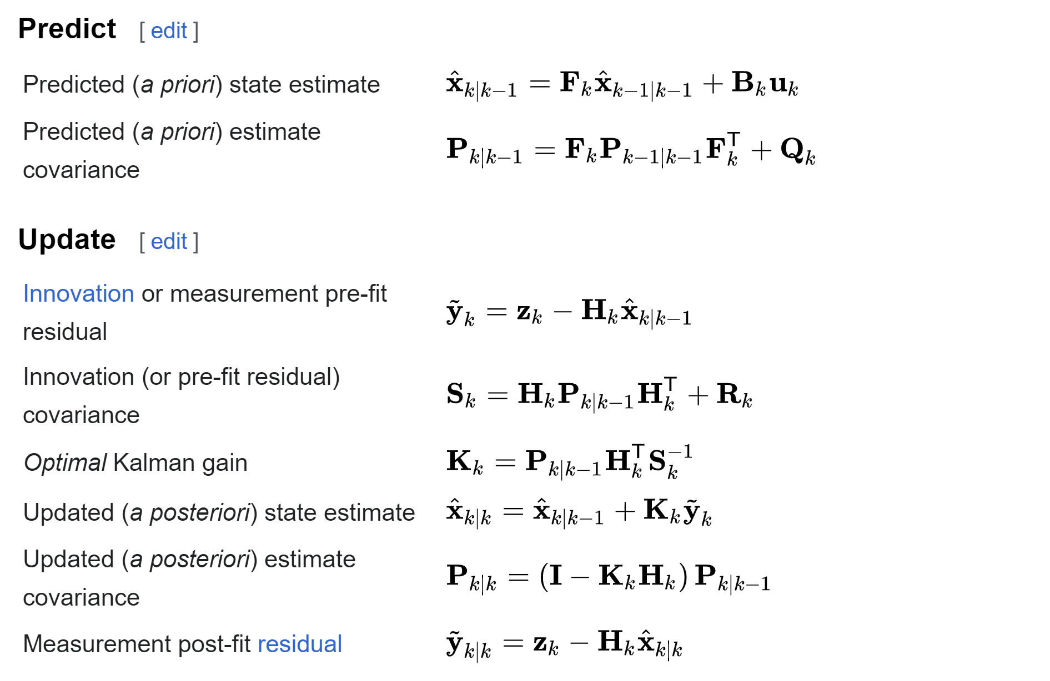
Introduction Familiarization With The Tools And Concepts In The Paper
Outline of KF from Wikipedia

Slide 14
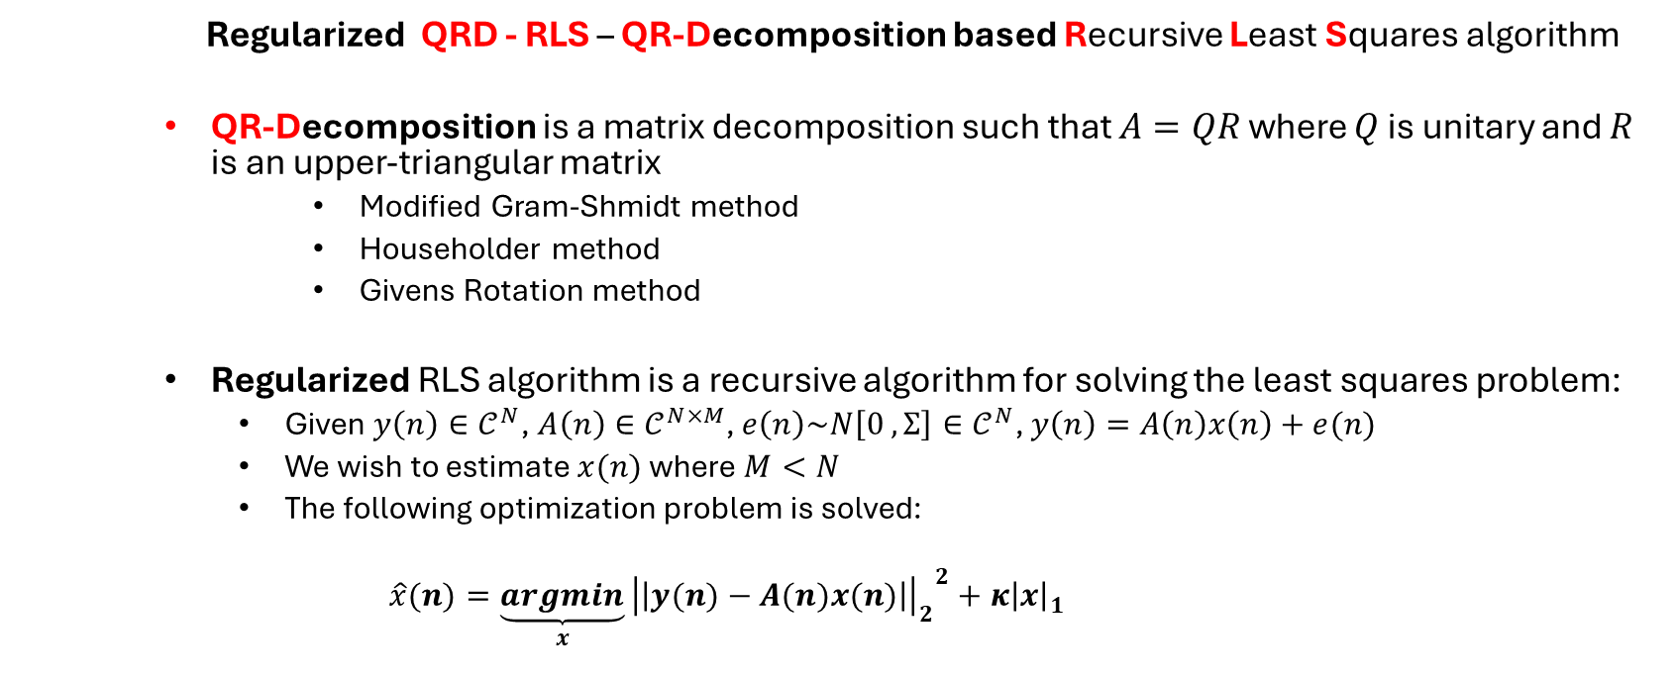
Introduction Familiarization With The Tools And Concepts In The Paper
Regularized QRD - RLS – QR-Decomposition based Recursive Least Squares algorithm
QR-Decomposition is a matrix decomposition such that $A=QR$ where $Q$ is unitary and $R$ is an upper-triangular matrix
Modified Gram-Shmidt method
Householder method
Givens Rotation method
Regularized RLS algorithm is a recursive algorithm for solving the least squares problem:
Given $y\left(n\right)∈𝒞^{N}$, $A\left(n\right)∈𝒞^{N×M}$, $e\left(n\right)\sim N\left[0 , Σ\right]∈𝒞^{N}$, $y\left(n\right)=A\left(n\right)x\left(n\right)+e(n)$
We wish to estimate $x(n)$ where $M<N$
The following optimization problem is solved:
$$\hat{x}(n)=\underset{x}{\underbrace{argmin}}{{\left|\left|y(n)−A(n)x(n)\right|\right|}_{2}}^{2}+κ{\left|x\right|}_{1}$$

Slide 15
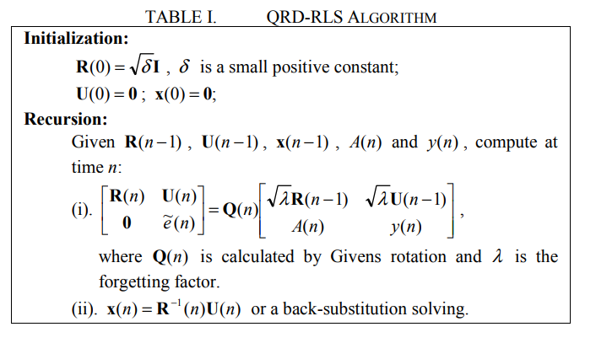
Introduction Familiarization With The Tools And Concepts In The Paper

Slide 16
Proposed Solution Outline
Use an array of Sensors
Model signal sources as complex valued AR processes (Reasonable In Many Real-Word Applications)
Get Measurements from a sensor array into a data matrix
Use Kalman-Filter to estimate signal statistics from measurements based on AR model
Use QRD-RLS algorithm to estimate DOA and AR parameters from estimated signal statistics.
Repeat

Slide 17
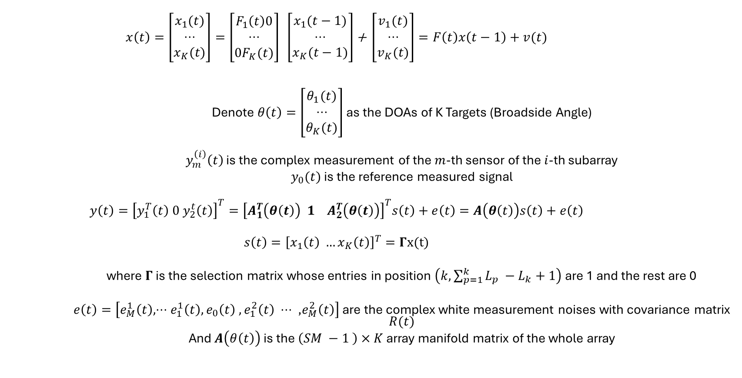
Proposed Solution Signal and Measurement Model
$$x\left(t\right)=\left[\begin{aligned}x_{1}(t) \\ ⋅⋅⋅ \\ x_{K}(t)\end{aligned}\right]=\left[\begin{aligned}F_{1}\left(t\right)0 \\ ⋅⋅⋅ \\ {0F}_{K}(t)\end{aligned}\right] \left[\begin{aligned}x_{1}(t−1) \\ ⋅⋅⋅ \\ x_{K}(t−1)\end{aligned}\right]\text{+} \left[\begin{aligned}v_{1}(t) \\ ⋅⋅⋅ \\ v_{K}(t)\end{aligned}\right]=F\left(t\right)x\left(t−1\right)+v(t)$$
Denote $θ\left(t\right)=\left[\begin{aligned}θ_{1}(t) \\ ⋅⋅⋅ \\ θ_{K}(t)\end{aligned}\right]$ as the DOAs of K Targets (Broadside Angle)
$y_{m}^{\left(i\right)}\left(t\right)$ is the complex measurement of the $m$-th sensor of the $i$-th subarray
$y_{0}(t)$ is the reference measured signal
$$y\left(t\right)={\left[y_{1}^{T}\left(t\right) 0 y_{2}^{t}\left(t\right)\right]}^{T}={\left[A_{1}^{T}\left(θ\left(t\right)\right) 1 A_{2}^{T}\left(θ\left(t\right)\right)\right]}^{T}s\left(t\right)+e\left(t\right)=A\left(θ\left(t\right)\right)s\left(t\right)+e\left(t\right)$$
$$s\left(t\right)={\left[x_{1}\left(t\right) …x_{K}\left(t\right)\right]}^{T}=Γx(t)$$
where $Γ$ is the selection matrix whose entries in position $\left(k,\sum_{p=1}^{k}{L_{p}} −L_{k}+1\right)$ are 1 and the rest are 0
$e\left(t\right)=\left[e_{M}^{1}\left(t\right),⋅⋅⋅e_{1}^{1}\left(t\right), e_{0}\left(t\right)\text{ ,} e_{1}^{2}\left(t\right) ⋅⋅⋅ \text{,}e_{M}^{2}\left(t\right)\right]$ are the complex white measurement noises with covariance matrix $R(t)$
And $A\left(θ\left(t\right)\right)$ is the $\left(SM −1 \right)×K$ array manifold matrix of the whole array

Slide 18
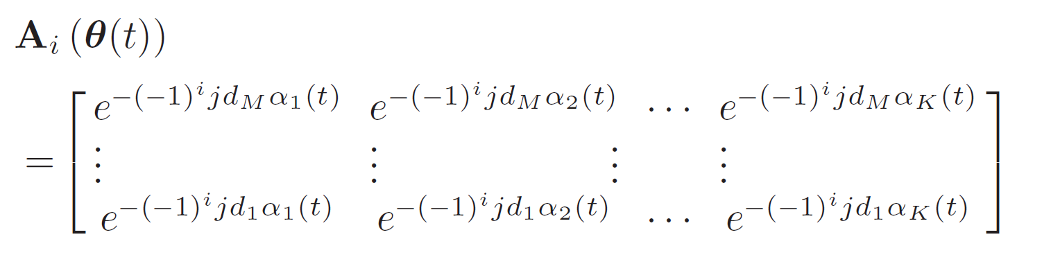

Proposed Solution Signal and Measurement Model

Slide 19

Proposed Solution Signal and Measurement Model
We can write $A\left(θ\left(t\right)\right)={\left[A_{1}^{T}\left(θ\left(t\right)\right)1_{1×M}^{T}J_{M}A_{1}^{H}\left(θ\left(t\right)\right)\right]}^{T}$
Where $J_{M}$ is an $M×M$ antidiagonal matrix with all entries equal to 1

Slide 20
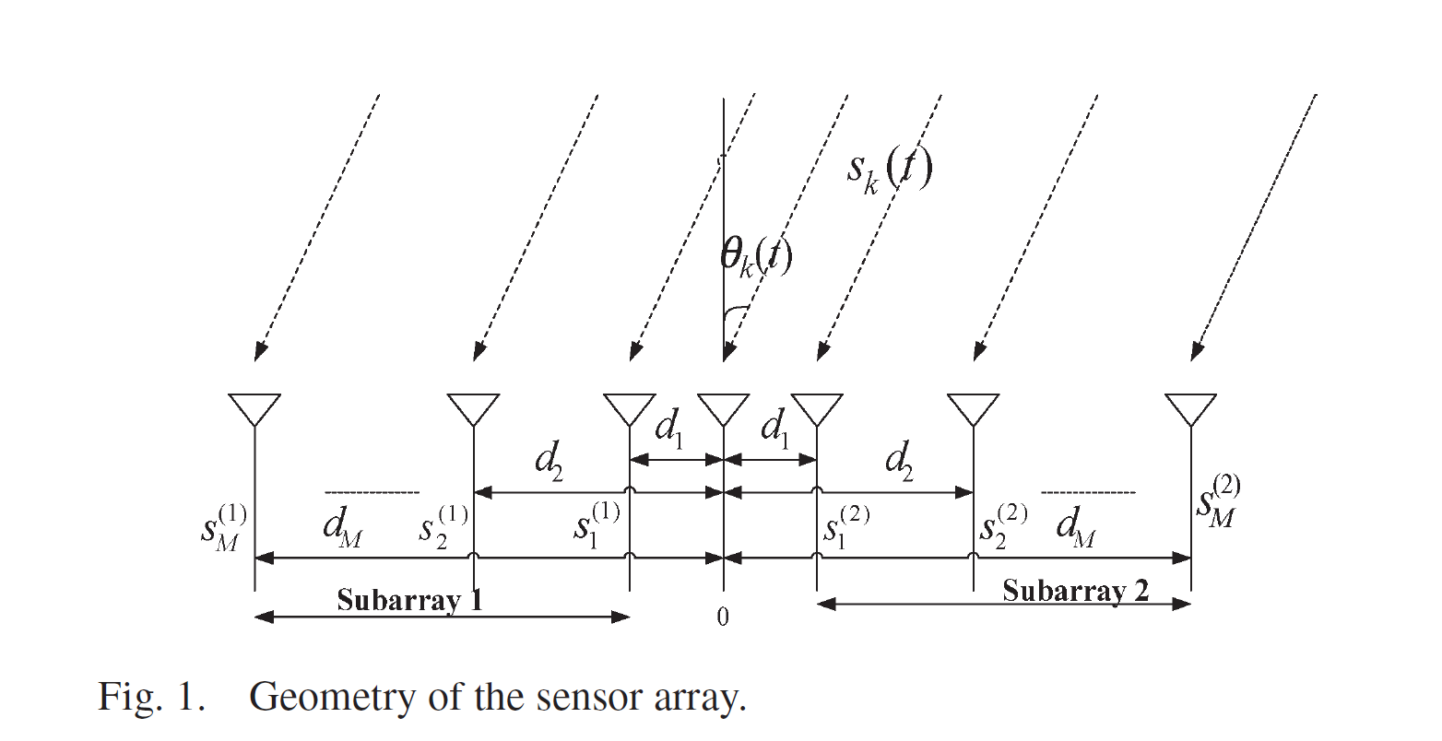
Proposed Solution Signal and Measurement Model

Slide 21
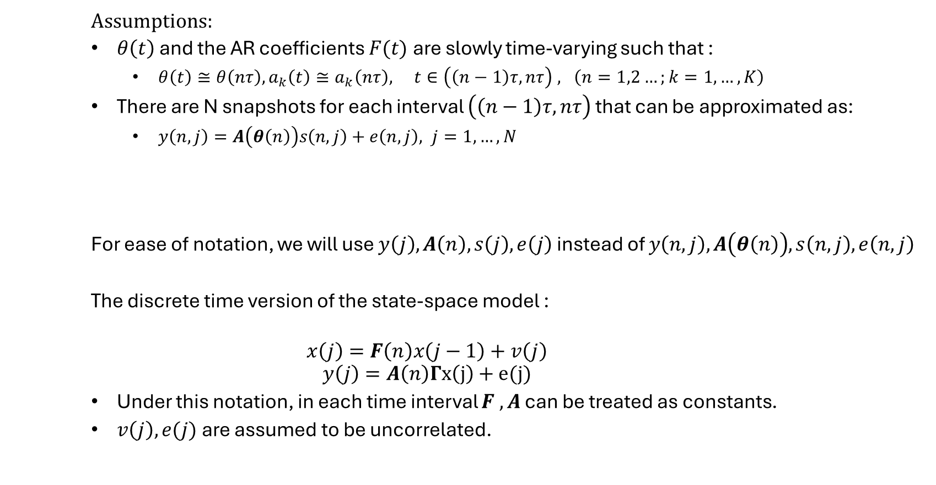
Proposed Solution KF and AR Coefficient Estimation
Assumptions:
$θ\left(t\right)$ and the AR coefficients $F(t)$are slowly time-varying such that :
$θ\left(t\right)≅θ\left(nτ\right), a_{k}\left(t\right)≅a_{k}\left(nτ\right), t∈\left(\left(n−1\right)τ,nτ\right) , \left(n=1,2…;k=1,…,K\right)$
There are N snapshots for each interval $\left(\left(n−1\right)τ,nτ\right)$ that can be approximated as:
$y\left(n,j\right)=A\left(θ\left(n\right)\right)s\left(n,j\right)+e\left(n,j\right), j=1,…,N$
For ease of notation, we will use $y\left(j\right),A\left(n\right),s\left(j\right),e\left(j\right)$ instead of $y\left(n,j\right),A\left(θ\left(n\right)\right),s\left(n,j\right),e\left(n,j\right)$
The discrete time version of the state-space model :
$$x\left(j\right)=F\left(n\right)x\left(j−1\right)+v\left(j\right)$$
$$y\left(j\right)=A\left(n\right)Γx\left(j\right)+e(j)$$
Under this notation, in each time interval $F , A$ can be treated as constants.
$v\left(j\right),e(j)$ are assumed to be uncorrelated.

Slide 22
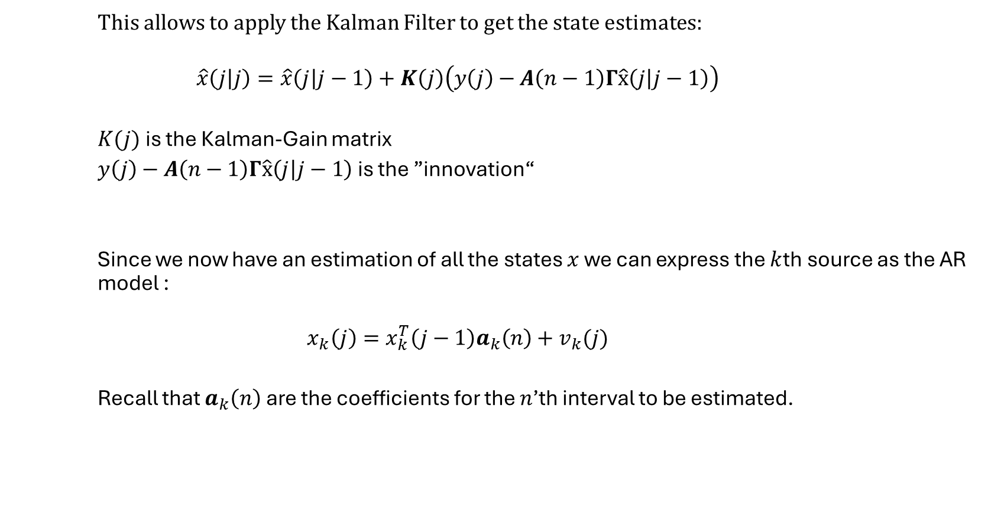
Proposed Solution KF and AR Coefficient Estimation
This allows to apply the Kalman Filter to get the state estimates:
$$\hat{x}\left(j | j\right)=\hat{x}\left(j | j−1\right)+K\left(j\right)\left(y\left(j\right)−A\left(n−1\right)Γ\hat{x}\left(j | j−1\right)\right)$$
$K(j)$ is the Kalman-Gain matrix
$y\left(j\right)−A\left(n−1\right)Γ\hat{x}\left(j | j−1\right)$ is the ”innovation“
Since we now have an estimation of all the states $x$ we can express the $k$th source as the AR model :
$$x_{k}\left(j\right)=x_{k}^{T}\left(j−1\right)a_{k}\left(n\right)+v_{k}(j)$$
Recall that $a_{k}\left(n\right)$ are the coefficients for the $n$’th interval to be estimated.

Slide 23
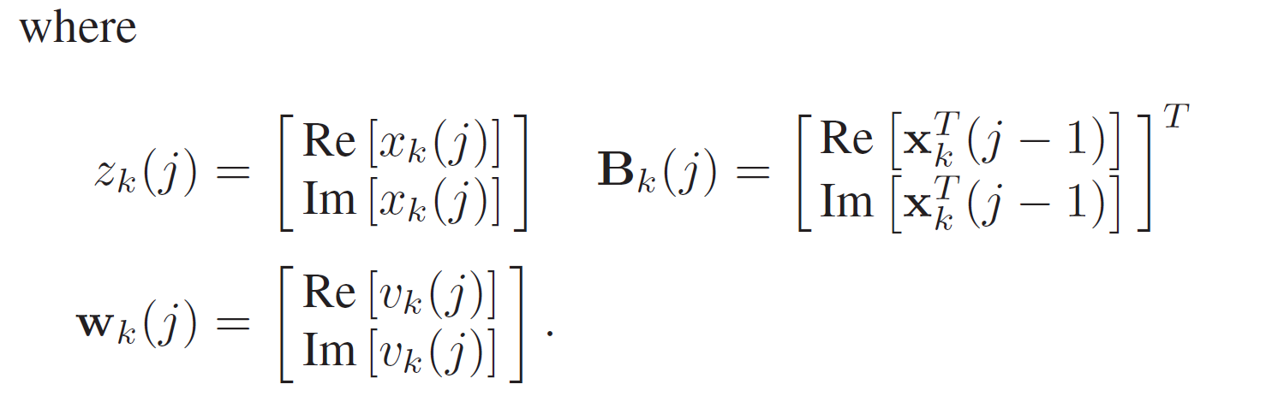
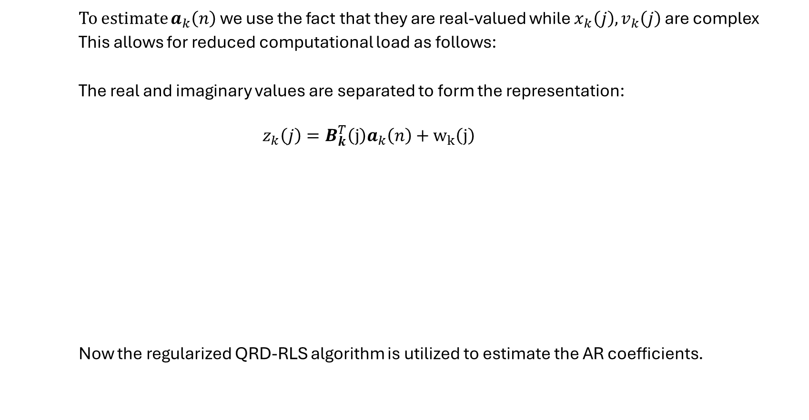
Proposed Solution KF and AR Coefficient Estimation
To estimate $a_{k}\left(n\right)$ we use the fact that they are real-valued while $x_{k}\left(j\right),v_{k}\left(j\right)$ are complex
This allows for reduced computational load as follows:
The real and imaginary values are separated to form the representation:
$$z_{k}\left(j\right)=B_{k}^{T}\left(j\right)a_{k}\left(n\right)+w_{k}\left(j\right)$$
Now the regularized QRD-RLS algorithm is utilized to estimate the AR coefficients.

Slide 24
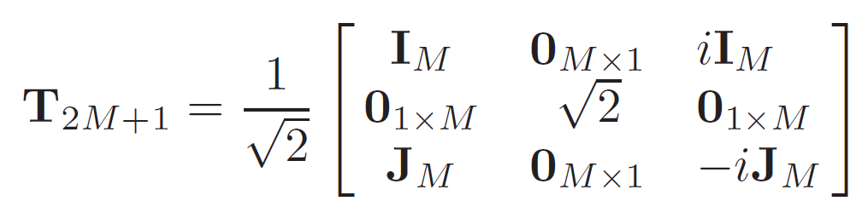
Proposed Solution DOA Estimation
The estimation of the DOA from the now estimated source signal and AR coefficients can now be performed using the QRD-RLS algorithm by Transforming the complex valued measurements to a real-valued representation.
The following Transformation is introduced:

Slide 25
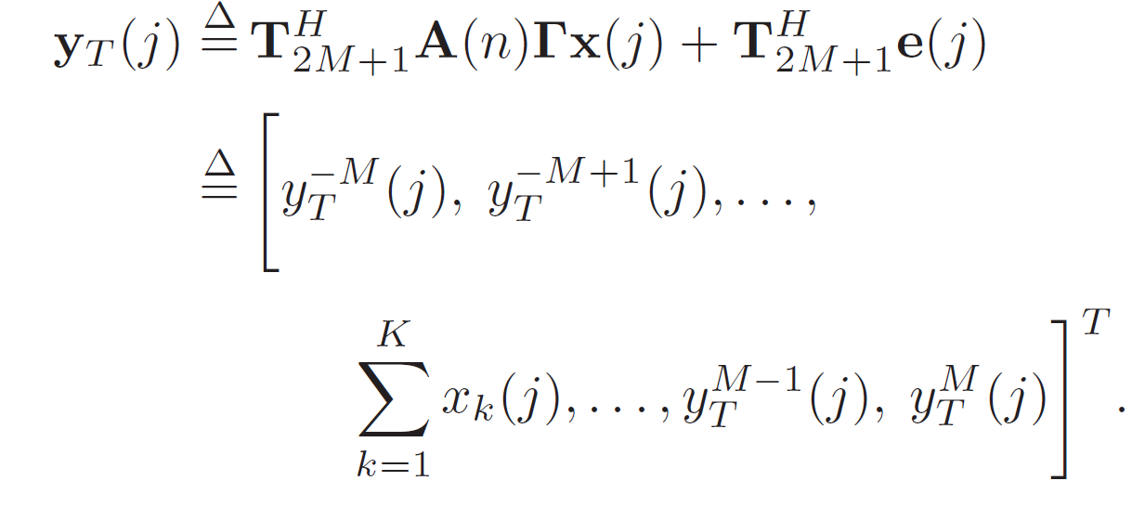
Proposed Solution DOA Estimation
Left-Multiplying the transformation with the measurement equation yields:

Slide 26
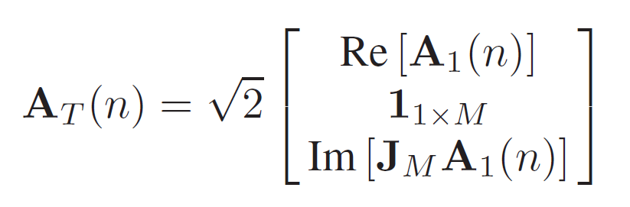
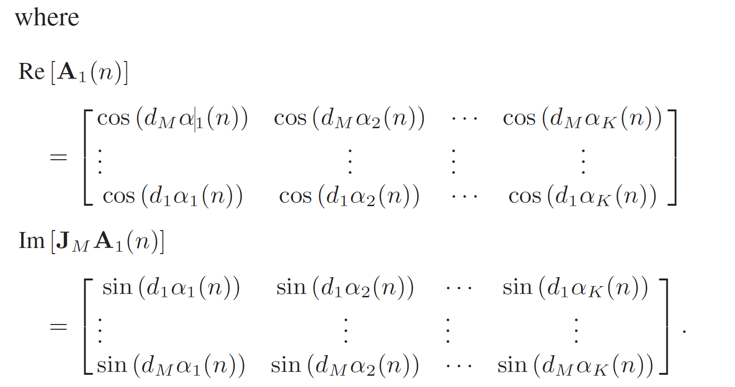

Proposed Solution DOA Estimation
Denote $A_{T}\left(n\right)=T_{2M+1}^{H}A(n)$ , then

Slide 27
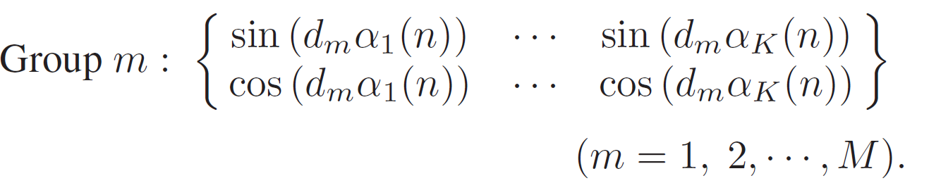
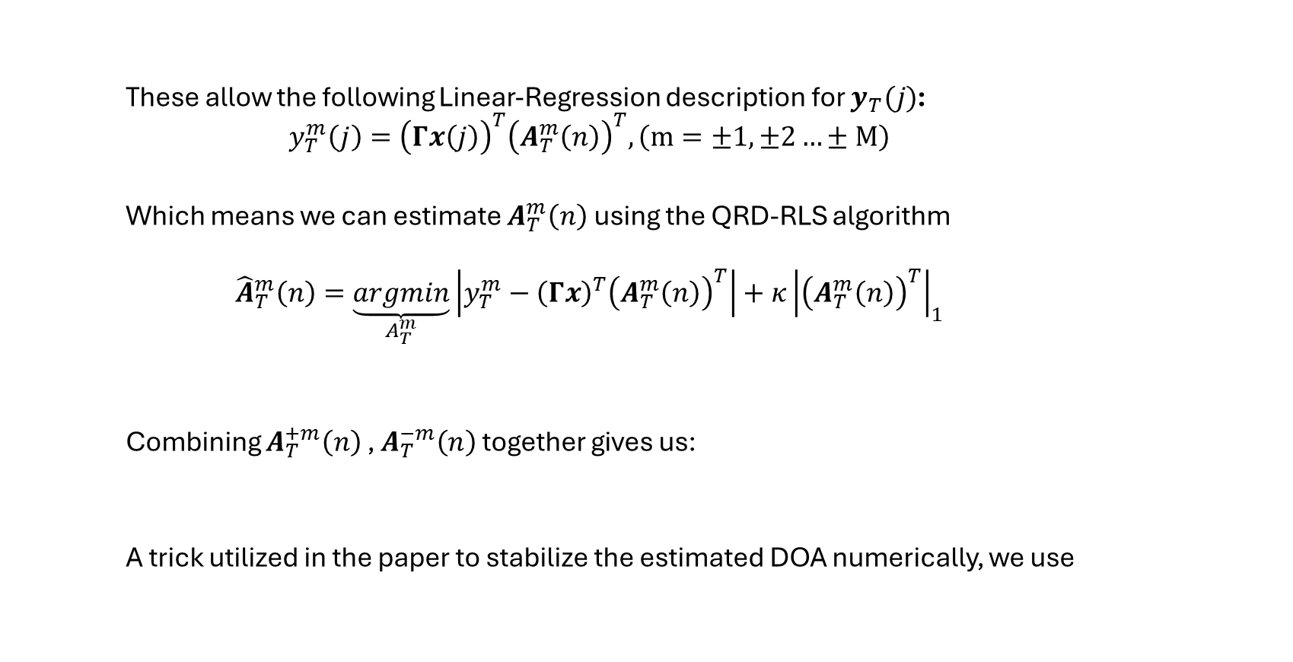
Proposed Solution DOA Estimation
These allow the following Linear-Regression description for $y_{T}(j)$:
$$y_{T}^{m}\left(j\right)={\left(Γx\left(j\right)\right)}^{T}{\left(A_{T}^{m}\left(n\right)\right)}^{T}, \left(m=±1,±2…±M\right)$$
Which means we can estimate $A_{T}^{m}\left(n\right)$ using the QRD-RLS algorithm
$${\hat{A}}_{T}^{m}\left(n\right)=\underset{A_{T}^{m}}{\underbrace{argmin}}\left|y_{T}^{m}−{\left(Γx\right)}^{T}{\left(A_{T}^{m}\left(n\right)\right)}^{T}\right|+κ{\left|{\left(A_{T}^{m}\left(n\right)\right)}^{T}\right|}_{1}$$
Combining $A_{T}^{+m}\left(n\right)$ , $A_{T}^{−m}\left(n\right)$ together gives us:
A trick utilized in the paper to stabilize the estimated DOA numerically, we use

Slide 28
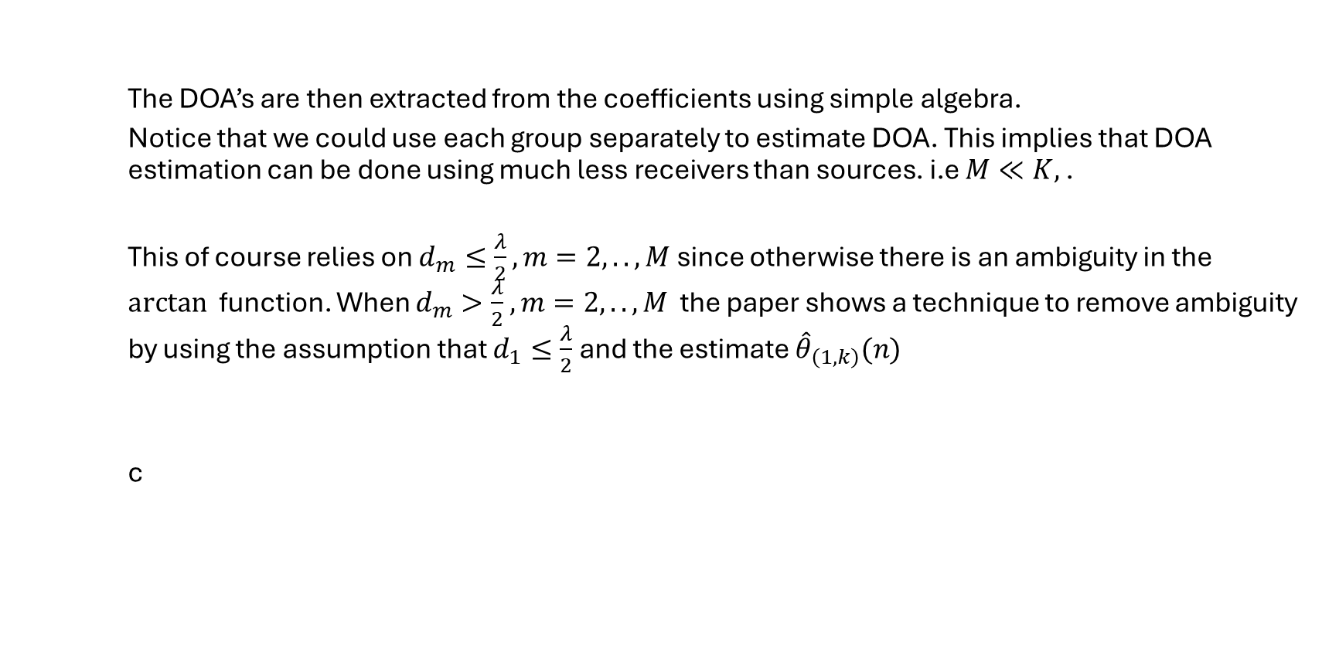
Proposed Solution DOA Estimation
The DOA’s are then extracted from the coefficients using simple algebra.
Notice that we could use each group separately to estimate DOA. This implies that DOA estimation can be done using much less receivers than sources. i.e $M≪K,$ .
This of course relies on $d_{m}≤\frac{λ}{2}, m=2,..,M$ since otherwise there is an ambiguity in the $arctan⁡$ function. When $d_{m}>\frac{λ}{2}$ $, m=2,..,M$ the paper shows a technique to remove ambiguity by using the assumption that $d_{1}≤\frac{λ}{2}$ and the estimate ${\hat{θ}}_{\left(1,k\right)}(n)$
c

Slide 29
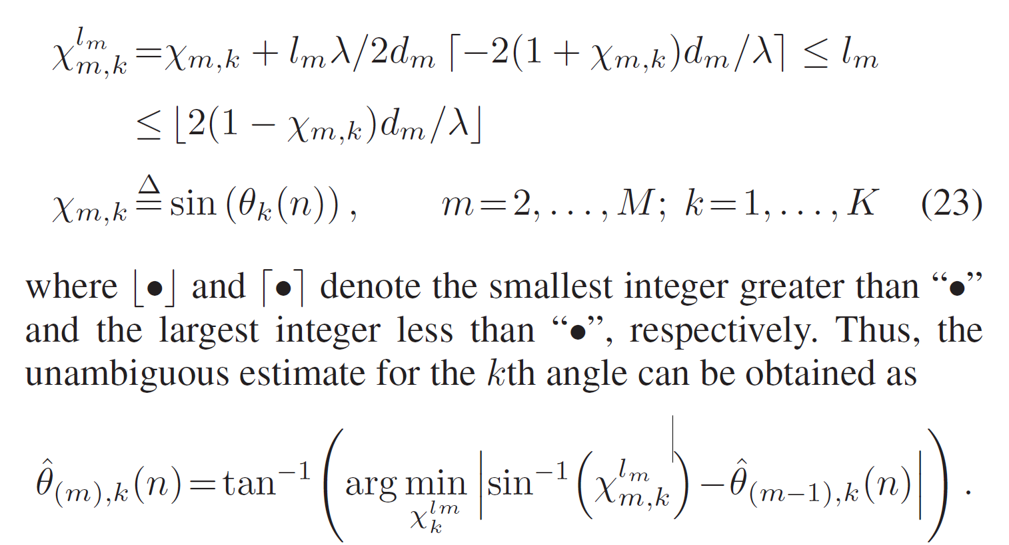
Proposed Solution DOA Estimation

Slide 30

Results and Conclusions
The following simulations are performed to analyze the performance of the proposed algorithm
3 Isotropic antennas spaced $d_{1}=\frac{λ}{4}$ apart . Sources are 2 second order AR stationary signals with an SNR of 30dB (Calculated as $\frac{Power of k^{′}th sensor}{E\left[e^{2}\left(t\right)\right]}$) . DOA’s are 0 and 20 degrees. N = 30
s

Slide 31
Results and Conclusions

Slide 32

Results and Conclusions
5 Sensors with $d_{1}=\frac{λ}{2}$ and $d_{2}=λ$ but now we assume AR coefficients are known (same values as before). SNR of signals is 10dB . Results are compared to PAST algorithm. DOA is changing with the following formula

Slide 33
Results and Conclusions

Slide 34
Results and Conclusions

Slide 35

Results and Conclusions
Advantages
Improved performance over PAST algorithm
Performance improved with N
Better DOA resolution compared to PAST
Better at tracking fast moving target compared to PAST
Robust to initial guess of the DOA values
Possible Disadvantages
Assumes AR model , need to assume K of each source and number of sources
Usage of KF requires a linear model
Possible Extension
Non-linear dynamics (Use EKF, Particle filters, etc..)
Only Second order AR processes were presented, it is interesting to see how it scales with $L_{k}$

Slide 36
Questions?

Slide 37
Thank You!

